Slide 1
City of Seattle - Public Services Investments
June 13, 2022
Notes:
Raise hands for
Who does Public Services Now?
Who doesn’t but considering it?
Tell experienced people they’re going to help share knowledge with colleagues as part of presentation.

Slide 2
Topics:
Public Services (PS) CDBG eligibility
City of Seattle overview of PS projects
Impact of CARES Act waivers on PS
Identifying emerging needs for PS
Notes:
Public Services eligible uses
History of how the City has used it’s PS dollars on response to homelessness
Impact of use during the pandemic and under CARES Act waivers
Facing the “cliff” of ending the pandemic money (rent assistance, extra temporary housing (hotels etc.) and end of eviction prevention legislation at the federal, state and local level.
Emerging need like addressing the opioid and fentanyl crisis

Slide 3
Eligible Public Services
Job Training
Crime Prevention
Childcare
Health & Substance Abuse
Energy conservation
Homeless and Senior Services
Notes:
Basically CDBG (November 2007) 7-1 HUD, Office of Block Grant Assistance Chapter 7: Public Services
The CDBG regulations allow the use of grant funds for a wide range of public service activities, including, but not limited to:
Employment services (e.g., job training);
Crime prevention and public safety;
Child care;
Health services;
Substance abuse services (e.g., counseling and treatment);
Fair housing counseling;
Education programs;
Energy conservation;
Services for senior citizens;
Services for homeless persons;
Welfare services (excluding income payments);
Recreational services.

Slide 4
Ineligible Public Services
Income Payments as a grant for basic needs
UNLESS; do not exceed 3 consecutive months; AND
Paid to a provider on behalf of person or HH
Basic needs loan allowed
No political activities
Notes:
7.1.2 Ineligible Public Service Activities The provision of “income payments” is an ineligible CDBG activity if these payments are provided as a grant. Income payments are payments to an individual or family, which are used to provide basic services such as food, shelter (including payment for rent, mortgage, and/or utilities) or clothing. However, such expenditures are eligible under the following conditions: The income payments do not exceed three consecutive months; and Basically CDBG (November 2007) 7-2 HUD, Office of Block Grant Assistance Chapter 7: Public Services The payments are made directly to the provider of such services on behalf of an individual or family. Income payments that are provided as a loan are permissible within the public services cap. Political activities are ineligible.
So how many grantees have done rent assistance? Mortgage assistance or utilities? How challenging is it to avoid duplication of benefit? Track limits of three consecutive months.
Even more complex when you have folks cycling from public housing, homelessness, rapid re-housing placements.
Also think about difference of operations cost for transitional housing versus, subsidizing cost of rent for specific HH.
So last one seems really obvious right??? How about a church that helps with one-time rent to get recent immigrants who might otherwise be homeless into housing? And what if those recipients were also active in the churches human rights advocacy activities? Not always clear answer; but diligent in questions and if unsure if activity is allowable—seek knowledgeable consult (maybe more experienced peer first then HUD rep.

Slide 5
City of Seattle PS Funding History
Public Services Cap for CDBG grantees
COS grandfathered at just under 36% of CDBG allocation in 1982
Used to address needs of people experiencing homelessness and/or housing instability
2023 allocation: $3,154,270 in CDBG, and $826,314 in ESG
Notes:
The total amount of CDBG funds obligated for public services activities must not exceed 15 percent of the annual grant allocation plus 15 percent of program income received during the prior year.
Regulatory/Statutory Citations: 570.201(e), 570.207
Even for the City at the higher grandfathered rate: generally calculate the cap WITHOUT the PI included to be sure we don’t overspend the cap!
Mention impact of CARES act money on PS. NO CAP! Could you spend it all? No Why?? Capacity of NPOS and staff, At same time COS ESG funds quadrupled just about overnight. How many spent for rent assistance?, how many for leases/ops on hotels? Added shelter, room in existing shelters?
But now that $$ ERA, CARES Act, CLFR $ is ending---we face the “cliff” of increased demand that may be cut off.

Slide 6
Examples of projects
ESG - $189,728, Catholic Community Housing - Street to Housing Rapid Rehousing, no barrier to program entry then progressive engagement of services.
CDBG - $2,644.527, 24-hour shelter services to single adults over 18. 241 bed units in socially distanced non-congregate shelter model.
Notes:
ESG $189,728
The Street to Housing RRH program is a short-term housing first intervention intended to quickly move households experiencing homelessness into housing. Housing First means that programs are no barrier and focus on moving people into housing before providing any other services. This program will have no barriers to program entry and will serve literally homeless families referred from Coordinated Entry for All (CEA). The case management model will follow the model in the Seattle-King County RRH Guidelines available on the Regional Homelessness Authority website. The case management and financial assistance model is rooted in progressive engagement based on the needs and goals of the household, with housing as the primary goal. This includes a minimum of monthly household driven case management, a Housing Stability Plan, and reassessment every 90 days with income documentation when financial assistance is provided.
CDBG $2,644,527.00
The Lighthouse Shelter at SoDo provides low barrier, Housing First 24-hour shelter service to single adults over the age of 18 who are experiencing homelessness. The shelter provides 241 bed units in a socially distanced non-congregate shelter model. Clients receive housing readiness and self-sufficiency assessments and are encouraged to work with the Enhanced Team which includes a Mental Health Specialist, Case Managers and Housing Navigators. The Enhanced Team utilizes a client centered strengths-based assessment approach to develop mutually agreed upon stability plans that include barrier identification and remediation, resource referrals, housing search, income/subsidy procurement assistance and support. Case managers coordinate support with the Mental Health Specialist when care is needed to address mental and/or emotional vulnerability issues. Clients who access housing will receive follow ups at 3, 6 and 12 months after placement to support stability and housing retention. The facility is a leased property of King County, which was renovated and established for public benefit for usage of shelter operations. The depiction of the 135,000 square foot facility is attached for reference. Note that this activity was also funded with CDBG in 2021 with no material changes.

Slide 7
Notes:
Overall, out CDBG and other grants have remained relatively constant between 2017 and 2023 in comparison to the other 3 grants. And we’ve continued to spend out all our PS available cap funds.
But what does CDBG public services investment mean in the bigger picture????
Next slide show you

Slide 8
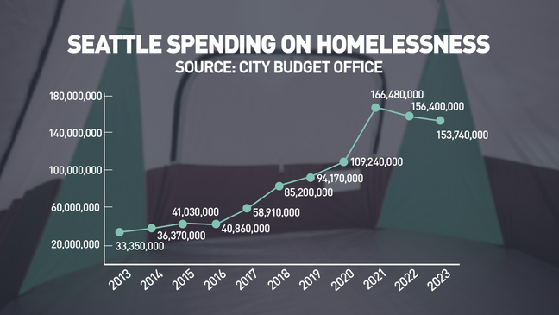
Source: Seattle City Budget Office via KOMO News Reporter Chris Daniels, 4/3/2023
Notes:
RATHER DRAMATICALLY
“After then-Mayor Ed Murray declared a homelessness state of emergency in 2015, the spending started to rise.
By 2018, the citywide budget ballooned to $85.2 million.
By 2021, that number had doubled to $166.48 million. Graph showing how much Seattle has spent on homelessness since 2013.”
The city started tracking the homelessness budget, including labor, in 2018. The totals do not reflect unspent amounts carried forward from a previous year into another year. But they also do not include other housing levies or spending on affordable housing.
Apr 3, 2023
Vast majority of this is General Funds, CDBG and ESG small proportion of it.
Why would we put this kind of $$ into this?

Slide 9
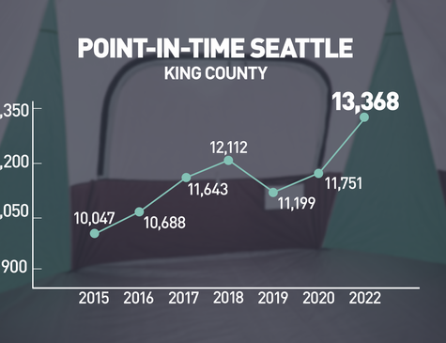
2022 King County Regional Homeless Authority PIT summary
Notes:
Big money investment----big need
This chart shows PIT count (how many know about that raise hands) for King County of which large chunk is Seattle from the same KOMO New Article 4/3/2023.
The Point in Time (PIT) Count is required by the U.S. Department of Housing and Urban Development (HUD). It is an estimate of people experiencing sheltered and unsheltered homelessness on a single night in King County. In prior years, the unsheltered PIT was conducted by volunteers during one night in January, using a combination of a census and survey. The PIT is widely understood to be an undercount, especially as it represents a single night rather than a full year.
Homelessness continues to have a disproportionate impact on communities of color even though 48% of the count sample were white. Based on the PIT analyses, 25% of people experiencing homelessness in King County identify as Black/AfricanAmerican, but according to the 2020 U.S. Census only 7% of King County's population identifies as Black/African-American. Similarly, 9% of people experiencing homelessness identify as American Indian, Alaskan Native, or Indigenous, but that group makes up only 1% of King County's population.
And relevant to next topic: Health Care needs of people who are unsheltered: 51% ID as having a disability; 31% having a mental health disorder; and 37% as having a substance abuse disorder. (Not necessarily mutually exclusive.)
Seattle/King County or Los Angeles/LA County worse data in 2022 13,368 v. 65,111
City of Seattle PIT data shows:

Slide 10
What’s next?
Consolidated Plan process needs assessment
Ongoing Community Engagement tells you what?
What are your public health and safety partners telling you?
In Seattle, overwhelmed with fentanyl and opioid overdosed crisis.
Notes:
How Con Plan and AAP data assessment help you see what's coming
Partners with knowledge (Public health boards, provider stakeholds, community and senior center data
For us emerging need is opioid and fentanyl crisis
Building urgency to address but could be facility for treatment; operations out of CDBG?
Supplanting, coordination with King County Regional Mental Health and Substance Abuse Treatment system
What should the priority be; always competing issues and not enough money but may have clear localized trend as with meth addiction ravages whole counties.
Tricky aspect of not supplanting local funding that should already be addressing. New issues or demonstrated new increase in demand.

